Slide 1


Cyclistic Case study
Analyzing bike riding data
Matthew Simpson
20/03/2022

Slide 2
What is my objective?
Discover how annual and casual members use Cyclistic bikes differently.
How will I answer this question?
I will analyze publicly available bike ride data, sourced from the Cyclistic database, using SQL and Tableau.

Slide 3
Reccomendations

Slide 4
Incentivise use when commuting for work

Slide 5
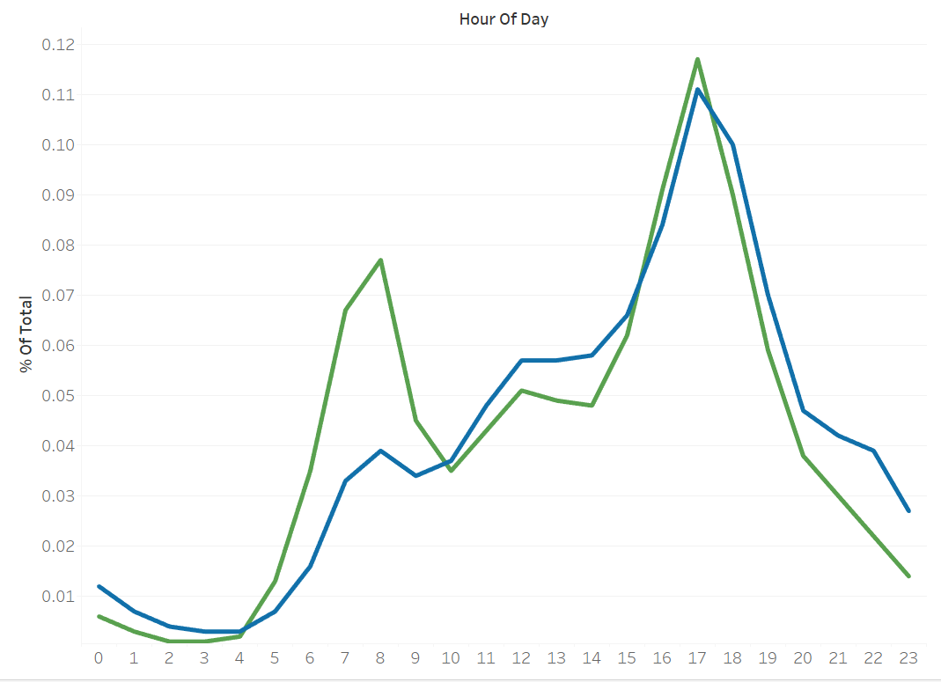
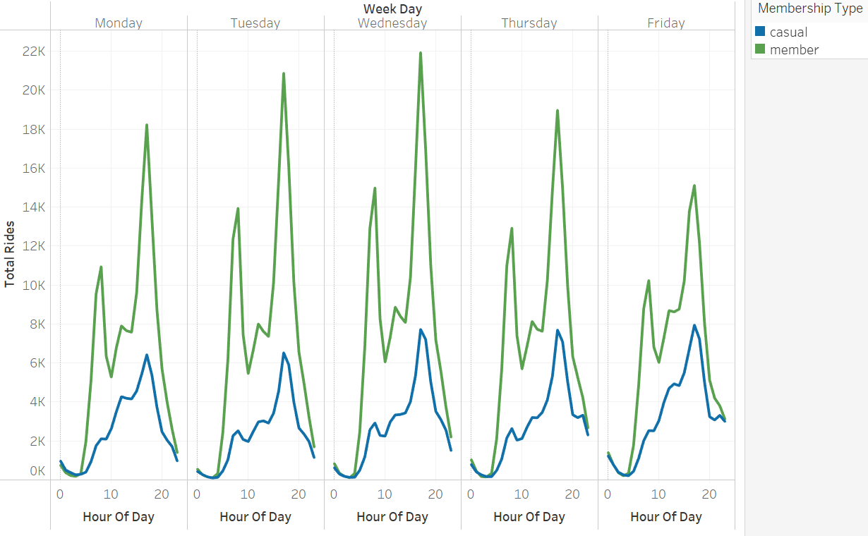
Incentivise use when commuting for work
Fig 1) % of total rides each hour for weekdays only
Trends
Sharp increase in ridership around the time workers are traveling to and from work.
Percentage of Total rides taking place during prime commuting hours equates to 49% for members and 40% for casual users.

Slide 6
Incentivise use when commuting for work
Conclusion
There is a strong trend of both types of members using Cylistic bikes to commute for work. However, annual members have a higher percentage of riders using their bikes during commuting times, aswell low level use for commuting to work in the morning.
I recommend advertising benefits for commuting to work in the morning as part of the annual membership. This could include:
Decreased hourly rates during peak commuting hours in the morning
Priority access to bikes
Integration into bike to work schemes

Slide 7
Subsidised cost for extended duration rides

Slide 8
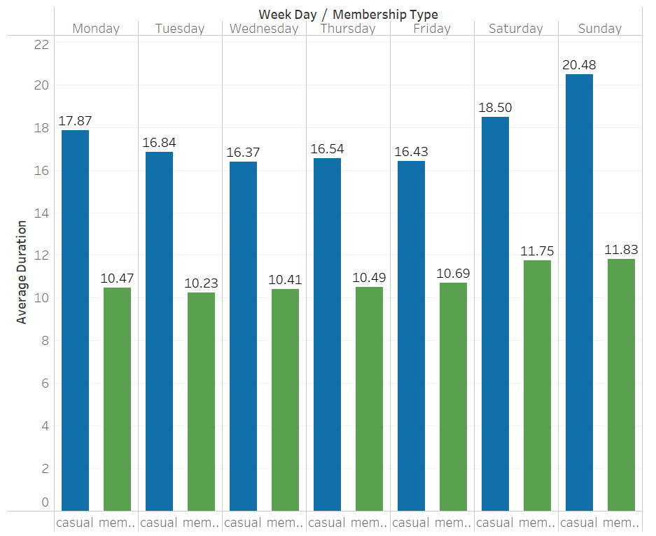
Subsidised cost for extended duration rides
Fig 2) Average duration each day of the week
Trends
Casual users have a longer 7 day average duration then members. (17.6 for casual and 10.8 for members)
Casual users exhibit a 16% increase in average ride duration during the weekend, when compared to weekdays.
Members exhibit a 13% difference

Slide 9
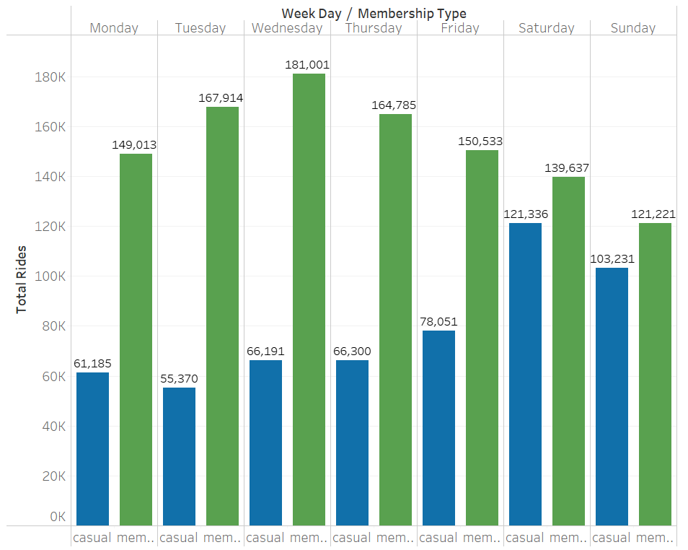
Subsidised cost for extended duration rides
Fig 3) Total number of rides each day of the week
Trends
Members bike usage peaks midweek and declines during the weekend
Casual users bike usage increased over the week and peaks during the weekend.
Casual users have a 72% increase from weekday to weekend and Annual members a 20% decrease

Slide 10
Subsidised cost for extended duration rides
Conclusion
Casual members use Cyclistic bikes 72% more during the weekend than during midweek, this is compounded with a 16% increase in average ride during the weekend. In contrast Members use Cyclistic bikes 20% less during the weekend.
I propose rewarding those users with an annual membership who use Cyclistic bikes in this manner by:
Decreasing hourly rates for Annual members for the weekend
Decreasing hourly rates for longer duration rides
Rewarding annual members with X free minutes each weekend.

Slide 11
Dynamic Seasonal promotion

Slide 12
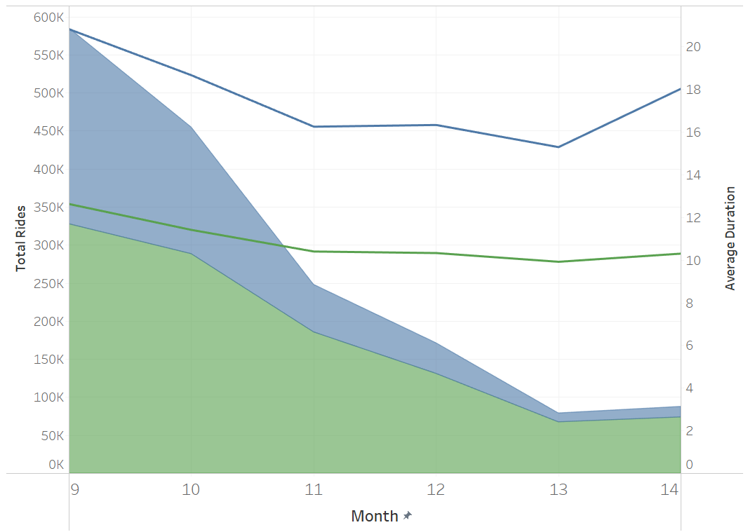
Dynamic Seasonal promotion
Fig 4 Total rides & average duration per month with average temperature
19.5°C
Trends
13°C
Total ridership decreases during towards the end of the year and into february
The percentage of casual riders decreases at a faster rate
6°C
0°C
-4°C
-2°C
1
2

Slide 13
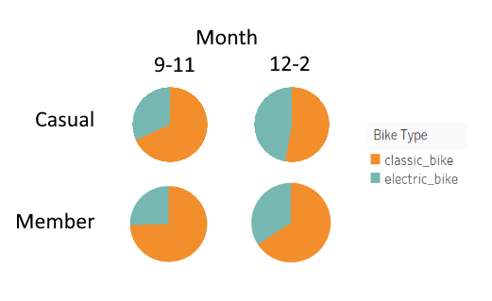
Dynamic Seasonal promotion
Fig 5 Proportion of electric bikes vs classic bikes
Trends
Electric bike usage increases during the colder months of the year
Casual users use electric bikes more than members
32%
47%
53%
68%
25%
44%
75%
66%

Slide 14
Dyanamic Seasonal promotion
Conclusion
Overall ridership decreases during the colder months of the year, especially for Casual users. However, this corresponds to an increase in electric bike usage, which Casual users already use more than Members.
A seasonal benefit for those with Annual memberships using Cyclistic during winter should include:
Decreased overall cost for both bike types (cheaper rate/free miles)
Highest discount for Electric bikes

Slide 15
Limitations and further analysis

Slide 16
Limitations & further analysis
Specific reccomendations
Making specific recommendations is difficult with only ride data. Further analysis to provide customer orientated recommendations would require pricing and customer data.
Data cleaning
The criteria used for data cleaning were created based on inferences made from the data itself. For futher analysis, liaising directly with the company to clear up confusion would avoid assumption.

Slide 17
Cleaning & Preparation

Slide 18
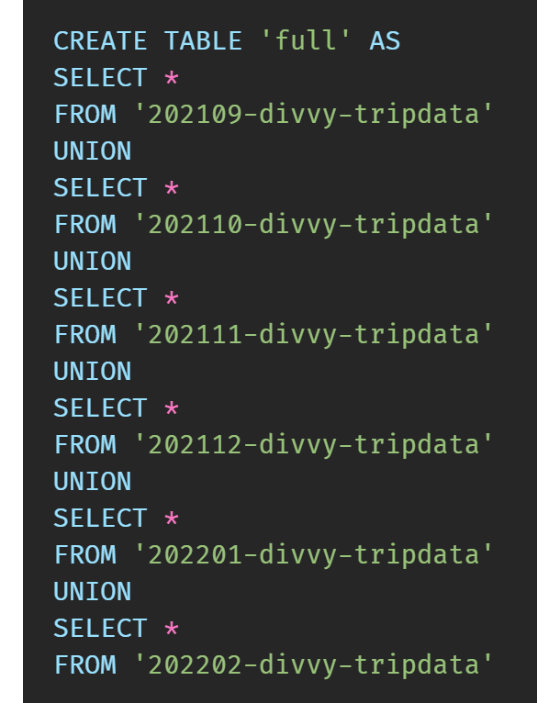
Collating monthly tables into a single six month table
Code
Union operator used for combination of all 6 months
Name ‘full’ used to denote all data
Ambiguous naming issues avoided by using standalone database

Slide 19
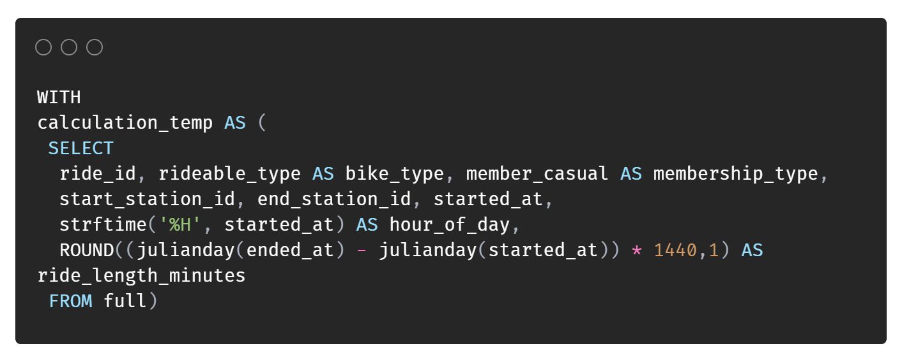
Transforming time-date values
Example
started_at | ended_at
2022-02-07 15:47:40 | 2022-02-07 15:49:28
2021-09-08 16:31:38 | 2021-09-08 16:37:54
Julianday function gives number which corresponds to days
Strftime takes specific values from a timedate string
Code

Slide 20
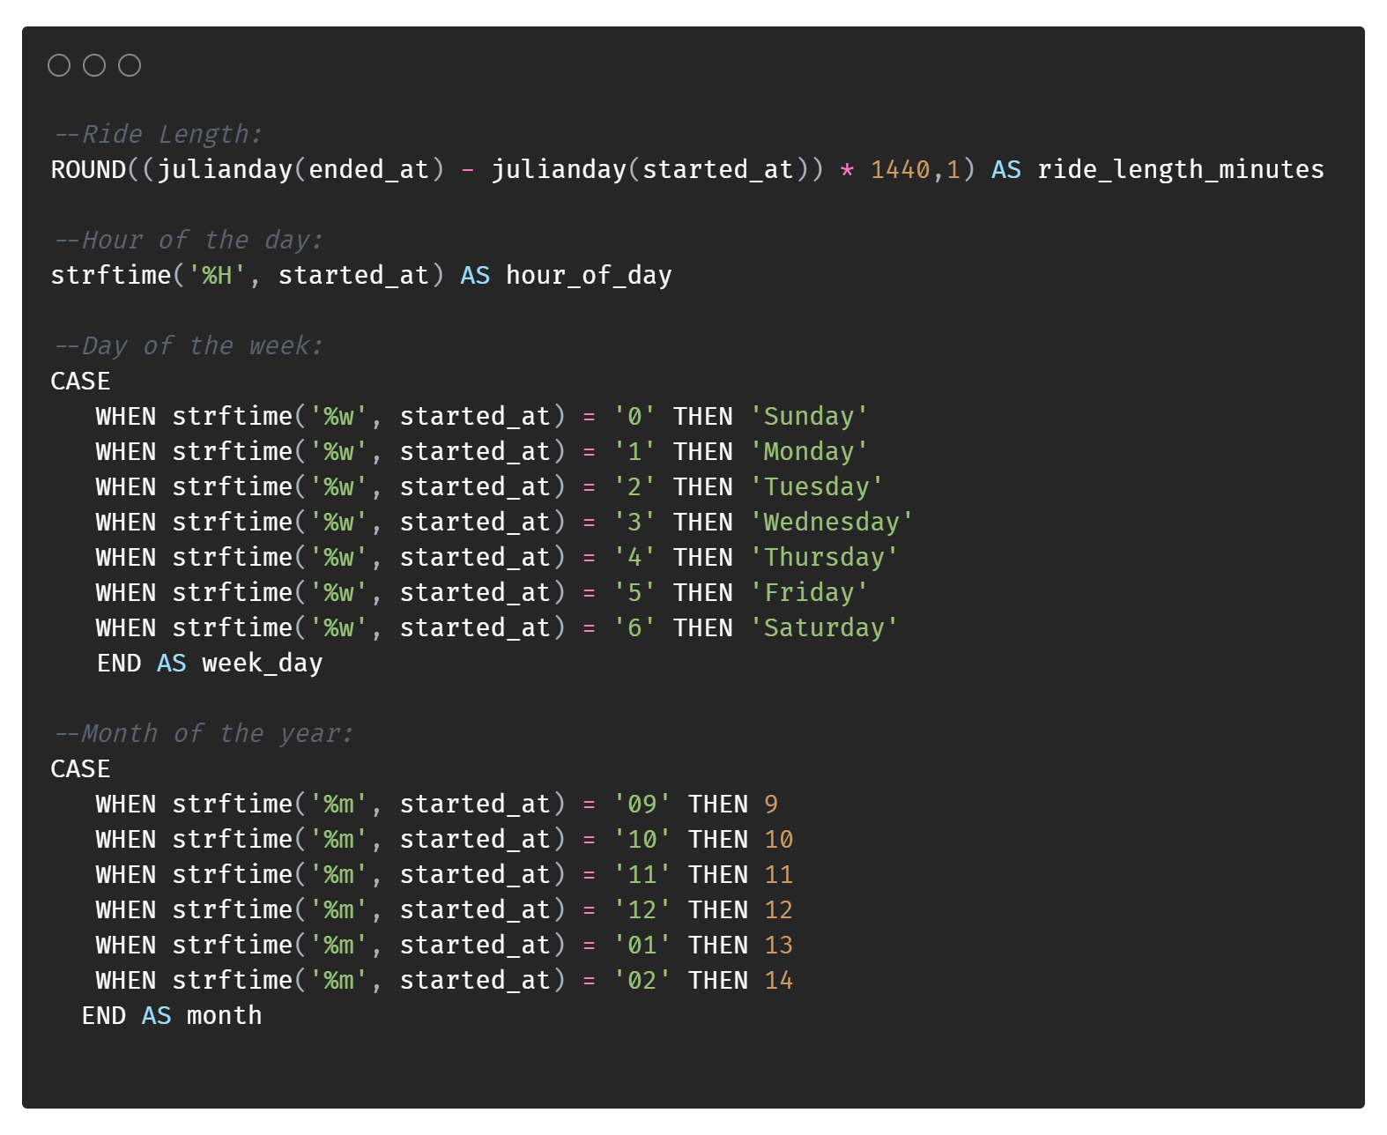
Transforming time-date values
Code
Case statement used to extract weekday and month and convert to different format
January and February were converted to 13 and 14 to ensure the correct order of months when analysing in Tableau

Slide 21
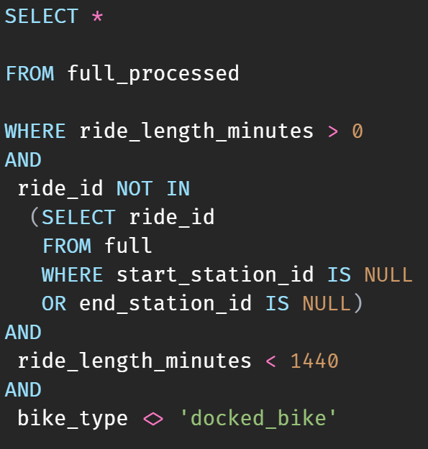
Removing null values, outliers and irellevent data
Code
Criteria for removal:
Ride length = 0 OR >1440
Any location data missing
Bike type = ‘docked_bike’ variant
33% of the data was removed, leaving 1.6M rows remaining.

Slide 22
Analysis

Slide 23
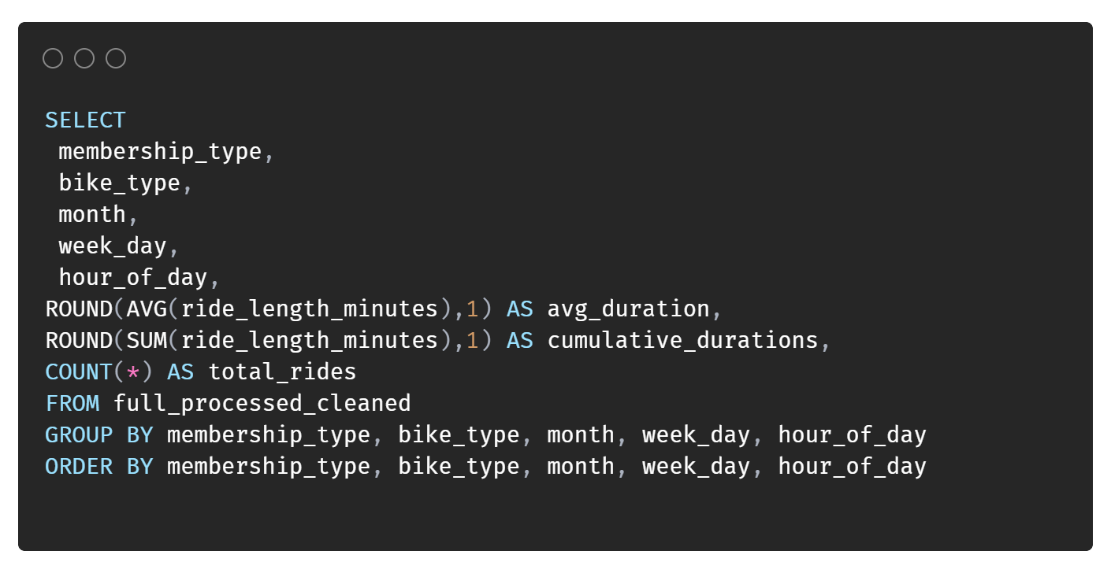
Aggregate functions
AVG function used for calculating average ride length
SUM function used to calculate the cumulative ride minutes
COUNT function used to calculate the number of individual rides
ROUND function to round the values from the aggregate functions that have many decimal points

Slide 24
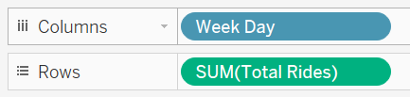
Aggregate functions
Tableau
Example of of inbuilt aggregation functions within Tableau

Slide 25
The End

